Slide 1
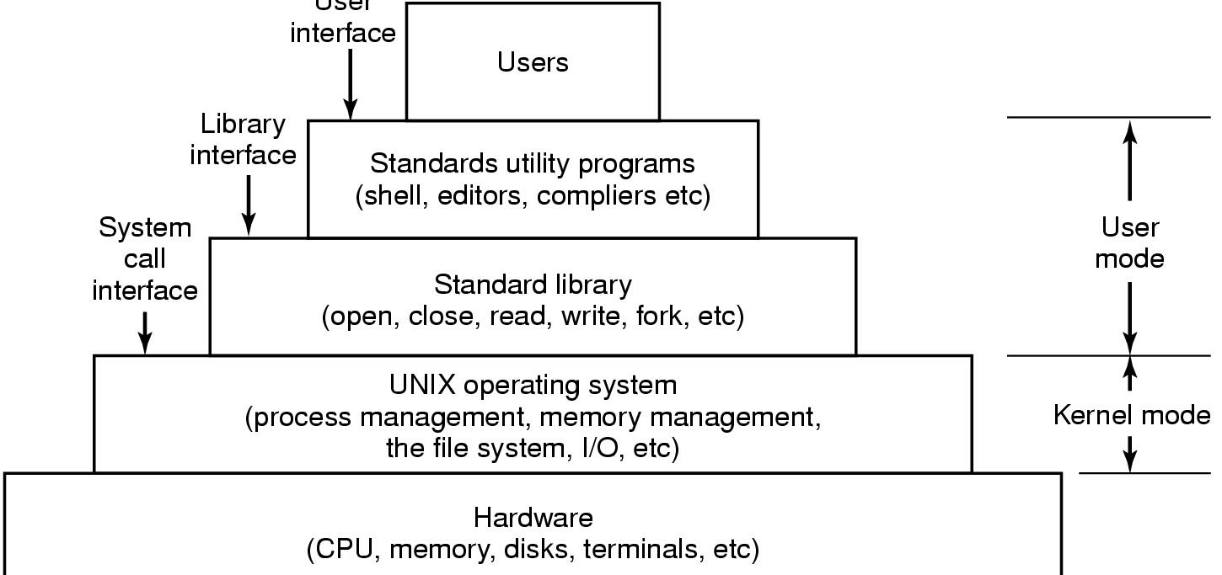
UNIX high-level architecture
https://www.cs.bgu.ac.il/~os142/Class_Material

Slide 2
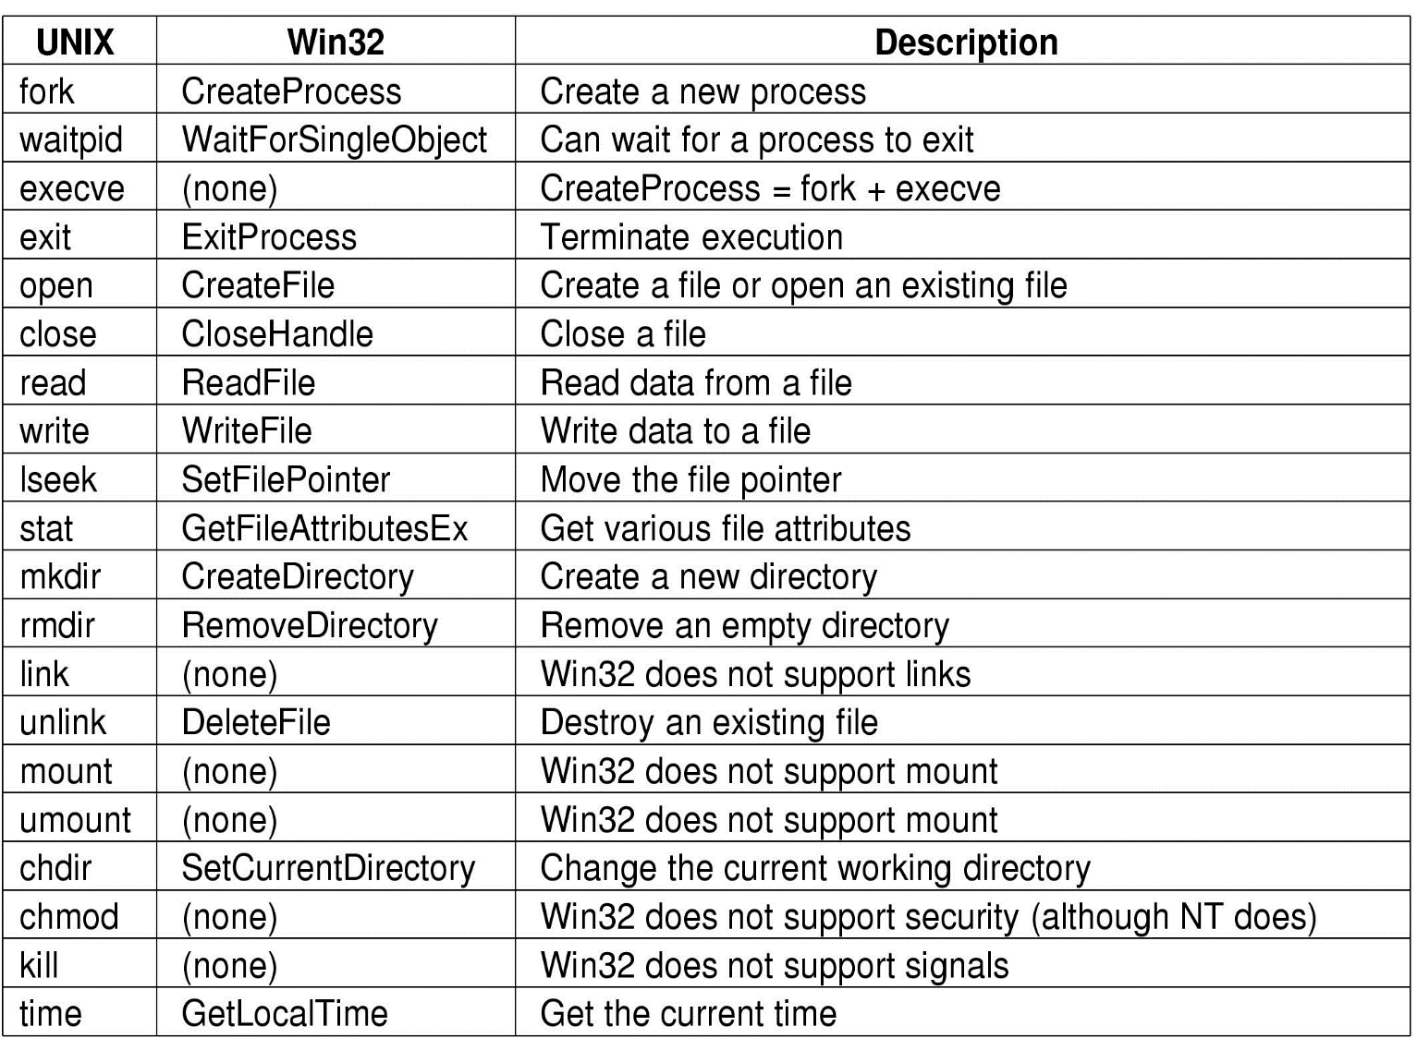
System Calls
processes
files
directories
miscellaneous
https://www.cs.bgu.ac.il/~os142/Class_Material

Slide 3
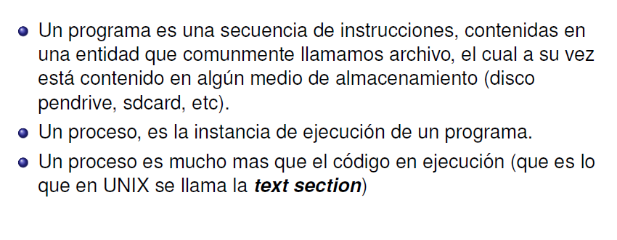
Que es un proceso?

Slide 4
Process Creation
When is a new process created?
System initialization (Daemons)
Execution of a process creation system call by a running process
A user request to create a process
Initiation of a batch job

Slide 5
Process Termination
When does a process terminate?
Normal exit (voluntary)
Error exit (voluntary)
Fatal error (involuntary)
Killed by another process (involuntary)

Slide 6
Process State Transitions
When do these transitions occur?
Running
1. Process blocks for input or waits for an event
2. End of time-slice, or preemption
3. Scheduler switches back to this process
4. Input becomes available, event arrives
1
2
3
Blocked
Ready
4

Slide 7
Five-State Process Model
Dispatch
Release
Admit
New
Ready
Running
Exit
Time-out
Event
Occurs
Event
Wait
Blocked

Slide 8
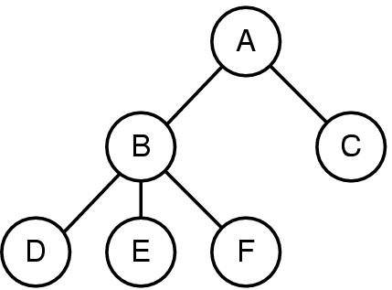
Process Tree
A process tree
A created two child processes, B and C
B created three child processes, D, E, and F
https://www.cs.bgu.ac.il/~os142/Class_Material

Slide 9
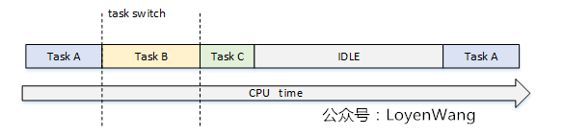
Process Scheduling

Slide 10
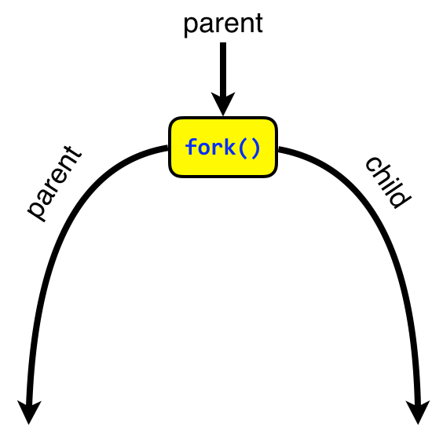
Process Tree
child_pid = pid proceso hijo
child_pid = 0
parent
child
http://www.it.uu.se/education/course/homepage/os/vt18/module-2/process-management/

Slide 11
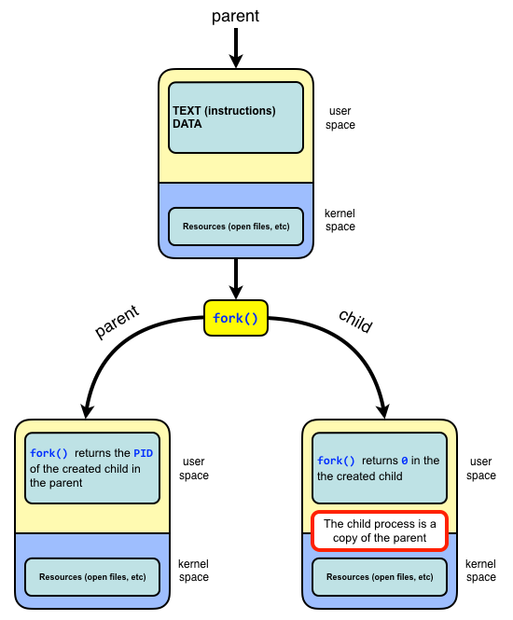
Process Tree
http://www.it.uu.se/education/course/homepage/os/vt18/module-2/process-management/

Slide 12
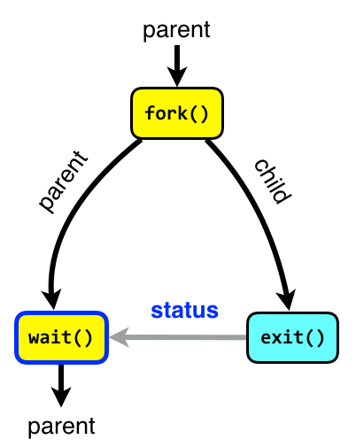
Process Tree
Orphans
An orphan process is a process whose parent process has terminated, though it remains running itself. Any orphaned process will be immediately adopted by the special init system process with PID 1.
Zombies
A terminated process is said to be a zombie or defunct until the parent does wait on the child.
When a process terminates all of the memory and resources associated with it are deallocated so they can be used by other processes.
However, the exit status is maintained in the PCB until the parent picks up the exit status using wait and deletes the PCB.
A child process always first becomes a zombie.
In most cases, under normal system operation zombies are immediately waited on by their parent.
Processes that stay zombies for a long time are generally an error and cause a resource leak.
http://www.it.uu.se/education/course/homepage/os/vt18/module-2/process-management/

Slide 13
padre
data.text
hijo

